Slide 1
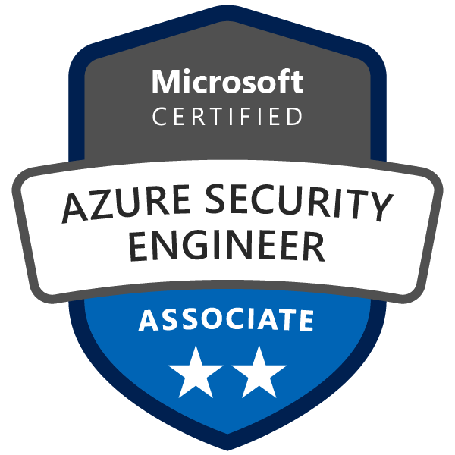
Exam AZ-500: Microsoft Azure Security Technologies Crash Course
Tim Warner

Slide 2


Tim Warner
Based in Nashville, TN, US
Central time zone
MCT, MVP
Twitter: @TechTrainerTim
Badge: TechTrainerTim.com

Slide 3
Course Materials
timw.info/az500

Slide 4
Course Materials
timw.info/frankenstein

Slide 5
Session 1 of 2 Learning Goals
Introduction
Manage identity and access
Implement platform protection

Slide 6
Session 2 of 2 Learning Goals
Manage security operations
Secure data and applications
Lots of AZ-500 tips and tricks!

Slide 7
A Different Kind of Training
Let's avoid slide show fatigue
We'll learn by doing – at least 80 percent demo
Case study/scenario approach
10-minute break at midpoint
I’m here to answer your questions – take advantage of this!
Use the Q&A panel

Slide 8
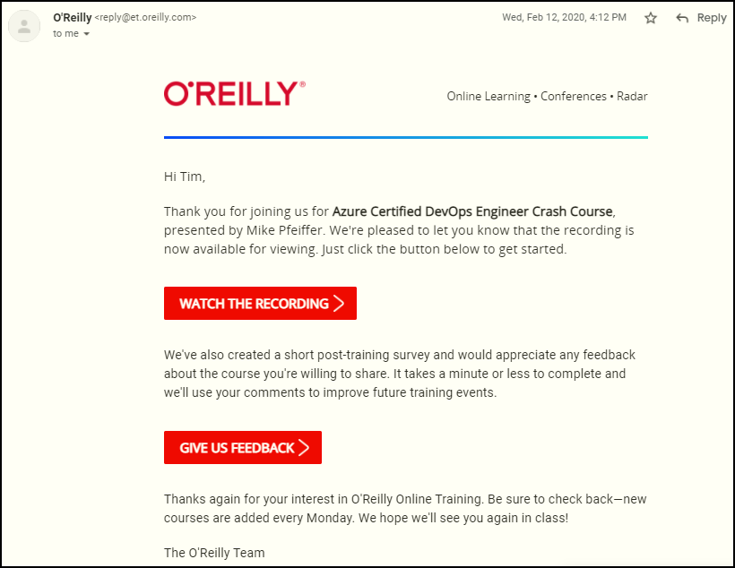
Session Recordings

Slide 9

Session Recordings

Slide 10

Session Recordings

Slide 11


Session Recordings

Slide 12
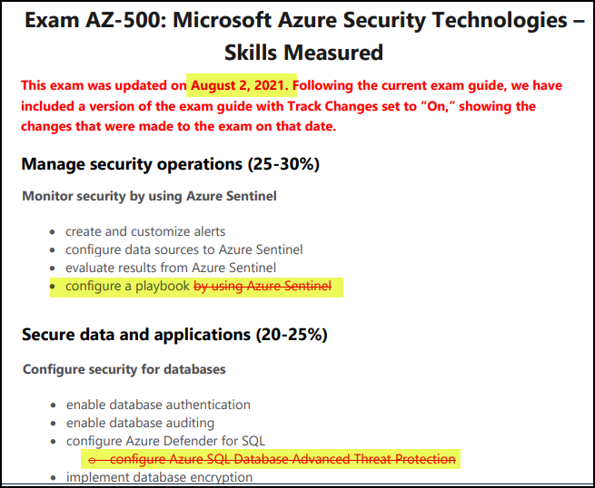
AZ-500 Changes: August 2, 2021

Slide 13
Certification Renewal
Associate and Expert certs are valid for one year
Credential will always be on your MS transcript
At six-month mark you’ll be asked to renew
Free online assessment at Microsoft Learn
Renewal extends your certification for 365 from original achievement date

Slide 14
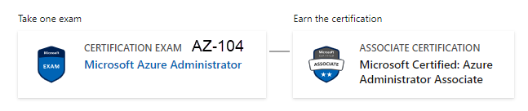
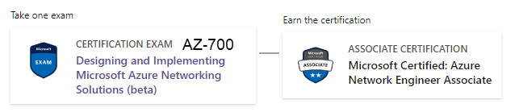
Related Certifications

Slide 15

Tim's Certification Study Model
Content knowledge
Test-taking skills
Practical application

Slide 16
Thank you!
Course materials: timw.info/az500
Twitter: @TechTrainerTim
Work: timw.info/ps
Web: TechTrainerTim.com

Slide 17
Manage Identity and Access

Slide 18
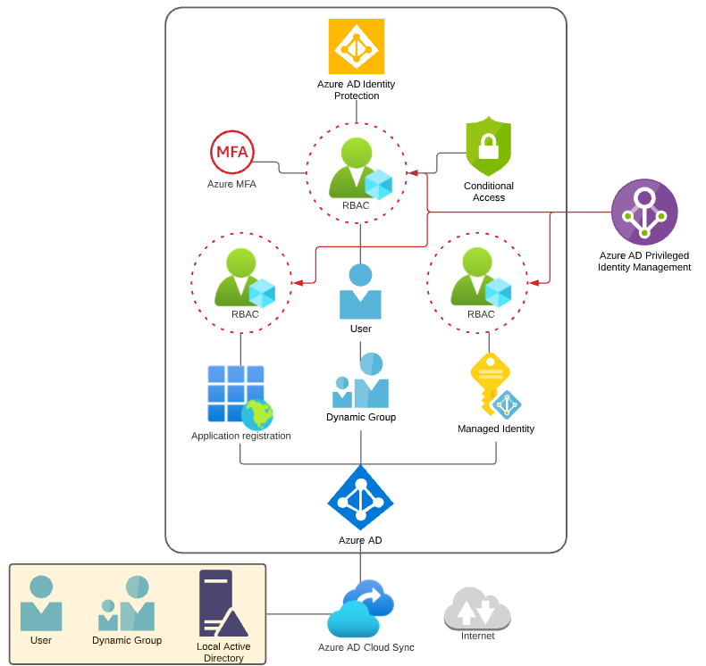
Identity and Access Scenario

Slide 19

Tenant vs. Subscription

Slide 20

Hybrid Identity

Slide 21

Passthrough Authentication

Slide 22

Seamless SSO

Slide 23
Seamless Single Sign-on

Slide 24

Azure Management Scopes
/ Tenant Root

Slide 25
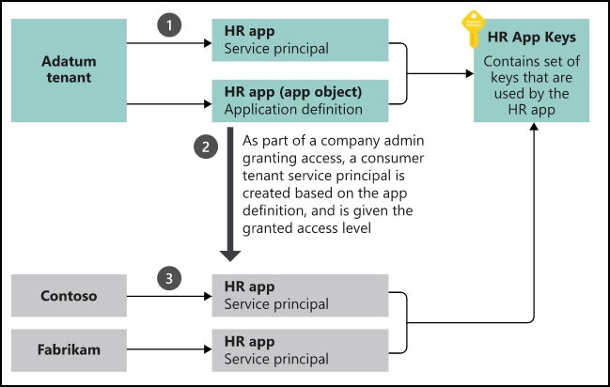
App registrations and service principals

Slide 26


Azure AD B2C

Slide 27

Azure AD Domain Services

Slide 28
Azure AD Connect

Slide 29
Passthrough Authentication

Slide 30

ADFS Federation

Slide 31
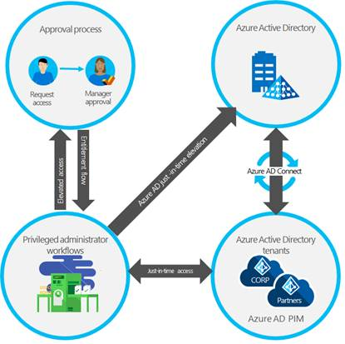
Azure AD PIM

Slide 32
Implement Platform Protection

Slide 33
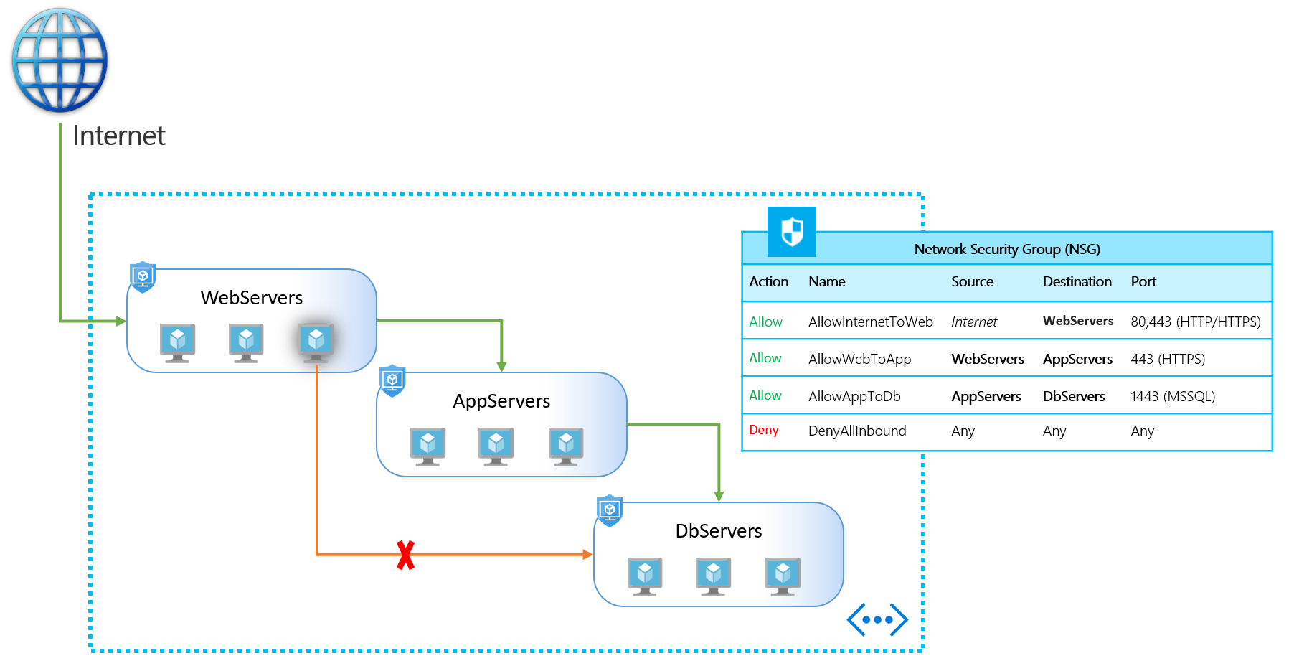
NSGs and ASGs

Slide 34

Multi-Region High Availability

Slide 35

Multi-Region High Availability

Slide 36
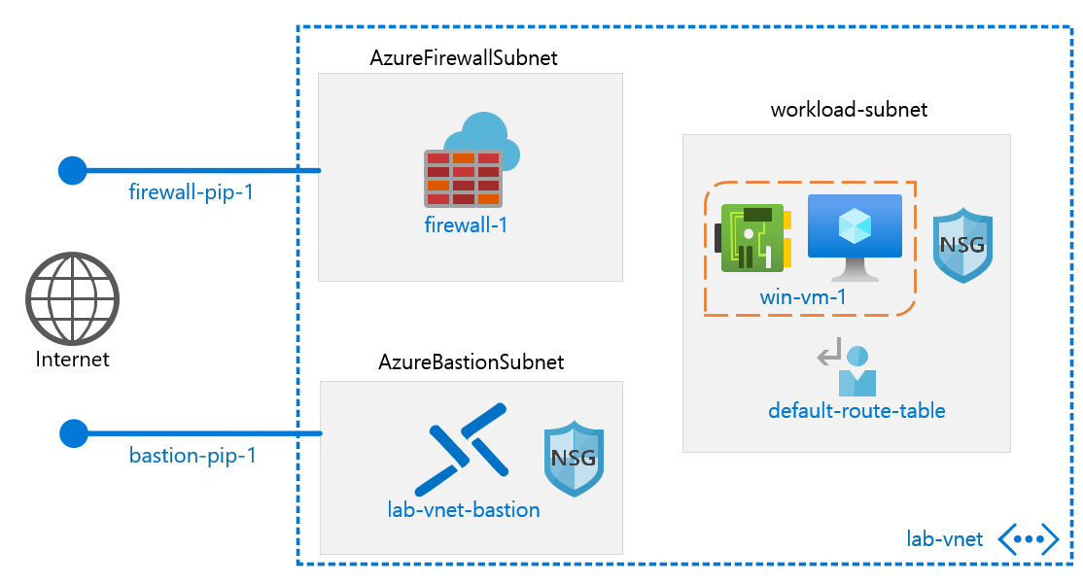
Azure Firewall

Slide 37
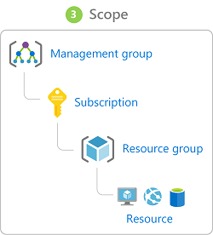
Management Scopes
/ Tenant Root

Slide 38

Service endpoints

Slide 39
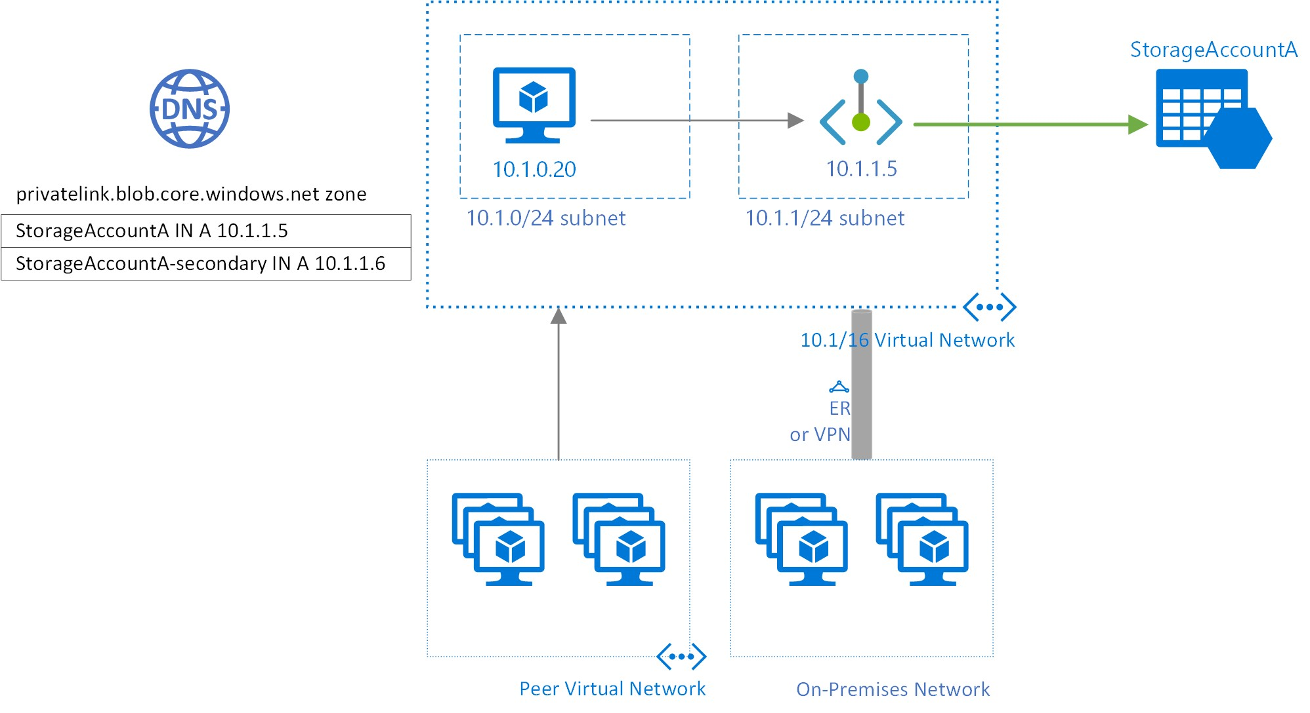
Private endpoints

Slide 40
Manage Security Operations

Slide 41
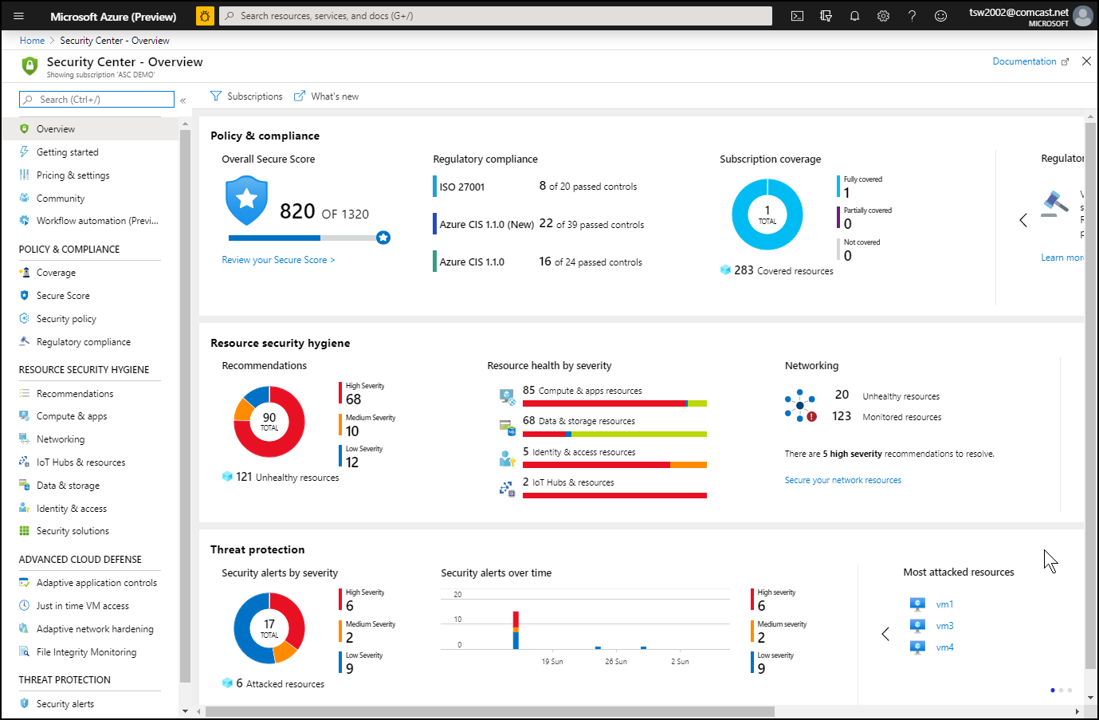
Azure Security Center

Slide 42
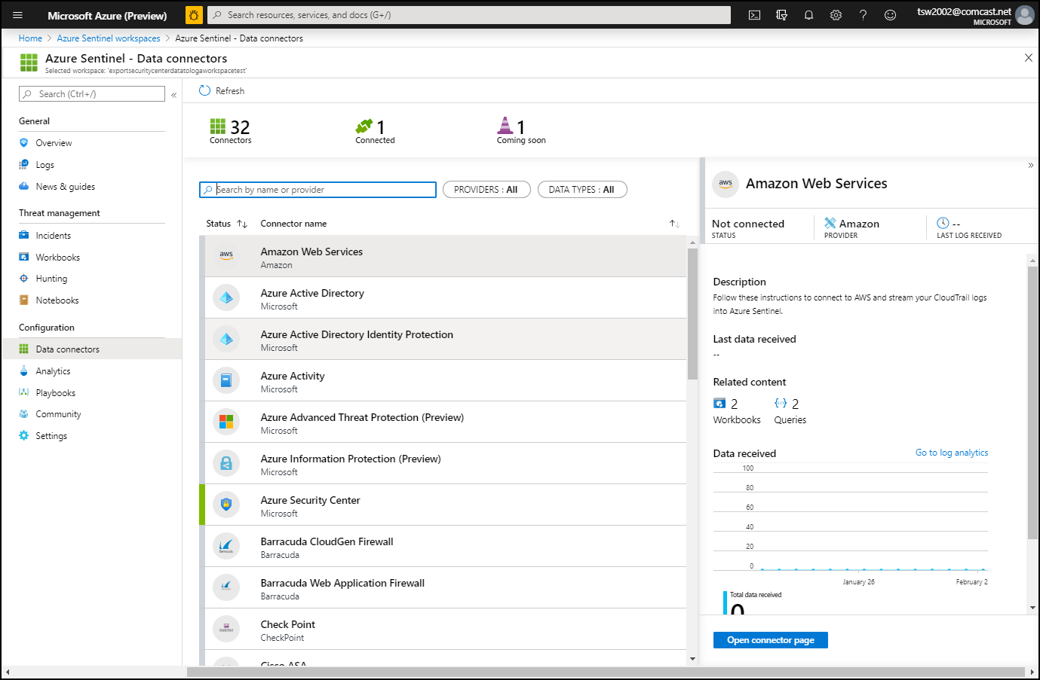
Azure Sentinel

Slide 43
Secure Data and Applications

Slide 44
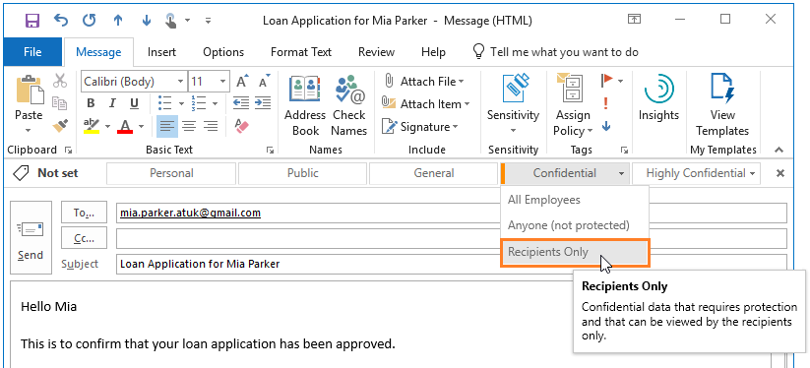
Azure Information Protection

Slide 45
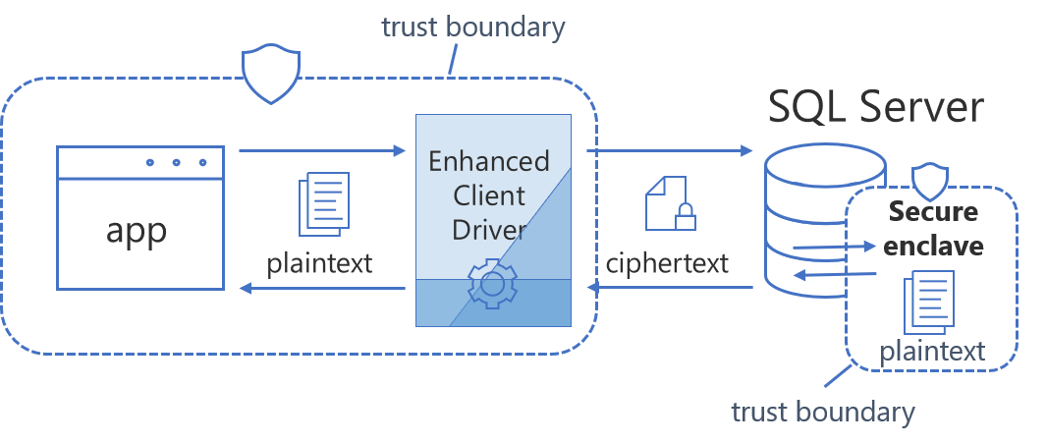
Always Encrypted

Slide 46
Compute and Networking

Slide 47
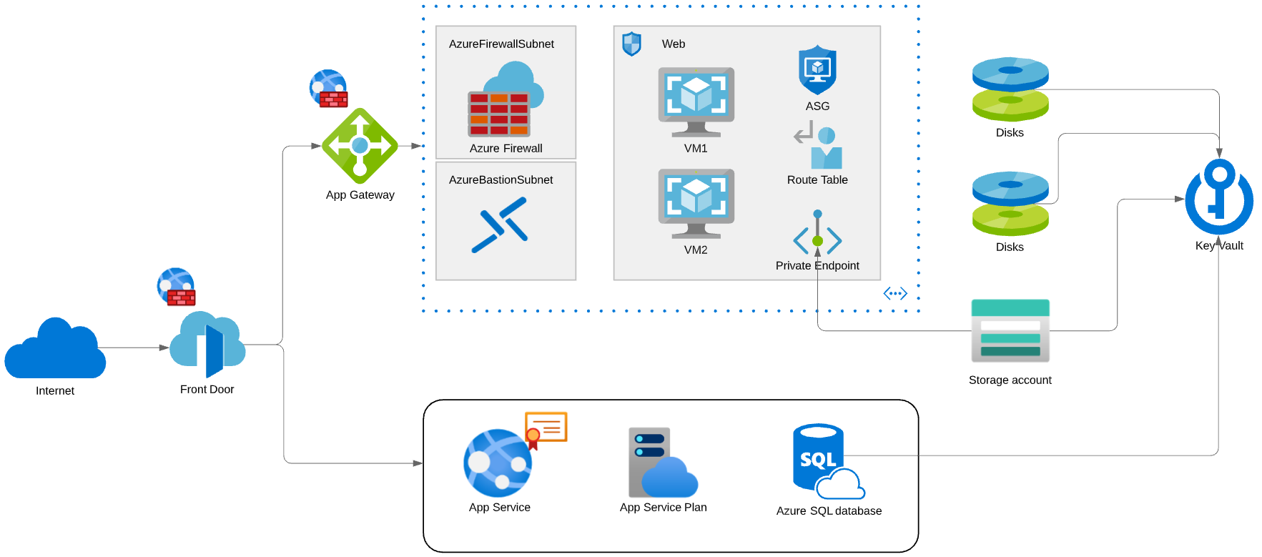
Compute and Networking Scenario

Slide 48
Security Operations

Slide 49
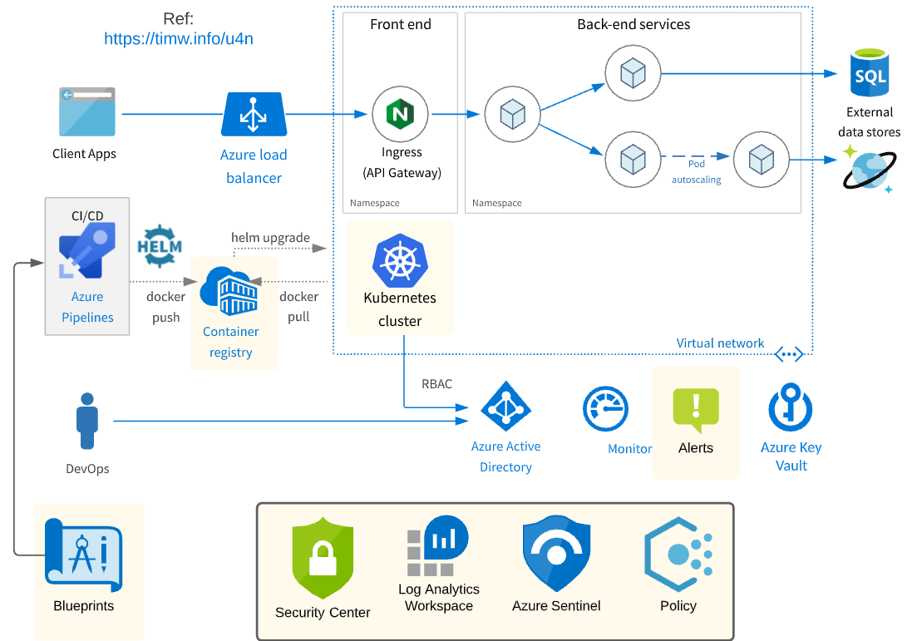
Security Operations Scenario

Slide 50
Exam AZ-500 Item Types

Slide 51

Single Answer Multiple Choice

Slide 52

Multiple Answer Multiple Choice

Slide 53
Repeated Scenario
You need to move an Azure VM to another hardware host.
Solution: You redeploy the VM.
Does this solution meet the goal?
Yes
No

Slide 54
Repeated Scenario
You need to move an Azure VM to another hardware host.
Solution: You enable boot diagnostics.
Does this solution meet the goal?
Yes
No

Slide 55

Select and Place

Slide 56

Build List and Reorder

Slide 57

Active Screen

Slide 58

Case Study

Slide 59






Performance-Based Testing

Slide 60
Microsoft Online Testing

Slide 61
Microsoft Online Testing Process
timw.info/online

Slide 62

Microsoft Online Testing Process

Slide 63

Microsoft Online Testing Process

Slide 64

Microsoft Online Testing Process

Slide 65

Microsoft Online Testing Process

Slide 66

Microsoft Online Testing Process

Slide 67

Microsoft Online Testing Process

Slide 68

Microsoft Online Testing Process

Slide 69
AZ-500 Exam Strategy
Focus your skills accordingly:
60 percent Azure portal
20 percent Azure PowerShell
10 percent Azure CLI
10 percent KQL
Azure AD PIM all day long
Expect performance-based labs, but be happy if you don't see 'em

Slide 70
Parting Advice
Check out my YouTube (timw.info)
Online testing
Cert item strategy
AZ-500 study guide
Invest in Whizlabs or MeasureUp
Register for your exam ASAP!

